Slide 1

Final Presentation
Team Ehrgo Health
04/30/16
Notes:
This template can be used as a starter file to give updates for project milestones.
Sections
Right-click on a slide to add sections. Sections can help to organize your slides or facilitate collaboration between multiple authors.
Notes
Use the Notes section for delivery notes or to provide additional details for the audience. View these notes in Presentation View during your presentation.
Keep in mind the font size (important for accessibility, visibility, videotaping, and online production)
Coordinated colors
Pay particular attention to the graphs, charts, and text boxes.
Consider that attendees will print in black and white or grayscale. Run a test print to make sure your colors work when printed in pure black and white and grayscale.
Graphics, tables, and graphs
Keep it simple: If possible, use consistent, non-distracting styles and colors.
Label all graphs and tables.

Slide 2
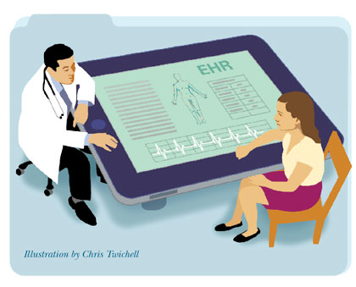
Project Overview
Plugin architecture to capture treatment analysis from EHR
Patient Portal: allowing patient to enter personal information and leverage commonly-used technology APIs such as fitbit
Provider EHR plugin: show warnings between allergies/medication and optimize treatment strategies
Notes:
What is the project about?
Define the goal of this project
Is it similar to projects in the past or is it a new effort?
Define the scope of this project
Is it an independent project or is it related to other projects?
* Note that this slide is not necessary for weekly status meetings

Slide 3
Objectives
Implement a rudimentary EHR
Implement a service that can analyze medical treatment plans
Plug the service into the EHR
Provide fitbit login’s, and allow users to import fitbit data
Create separate patient, and staff portals.
Save user data back to a central Fhir server, no patient data stored locally.

Slide 4
Project Successes
Flawless Fitbit Integration
Heavy use of backend fhir servers
Decoupled from one particular server, multiple fhir endpoints could be used
Extensible Algorithm for detecting issues with medical orders
Decoupled MVC based architecture

Slide 5
Future Opportunities
Dietary fitbit data could be used for better medical analysis, like how certain foods interact with certain medications
Allow staff to view other fitbit data like weight, height, etc.
Allow staff to provide feedback on current dietary information
Allow other EHR’s to plugin to the service

Slide 6
Architecture
Complete
In Work
Not Started
Architecture
EHR Framework
Patient Data Get/Set View
Calculate Optimal Treatment View
Alert Service
Data Entry
Plan
Treatment Plan Service
EHR Provider Plugin
Decider Process
Patient App
Public Interface
Patient Data Interface
FHIR DB
EHR Repositories
EHR Repositories
EHR Repository
EHR Repository
Fitbit Data Repository
Patient Data Repository

Slide 7
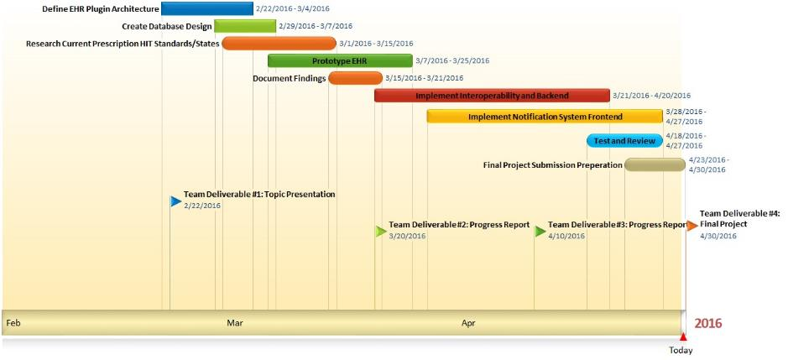
Final Gantt Chart

Slide 8
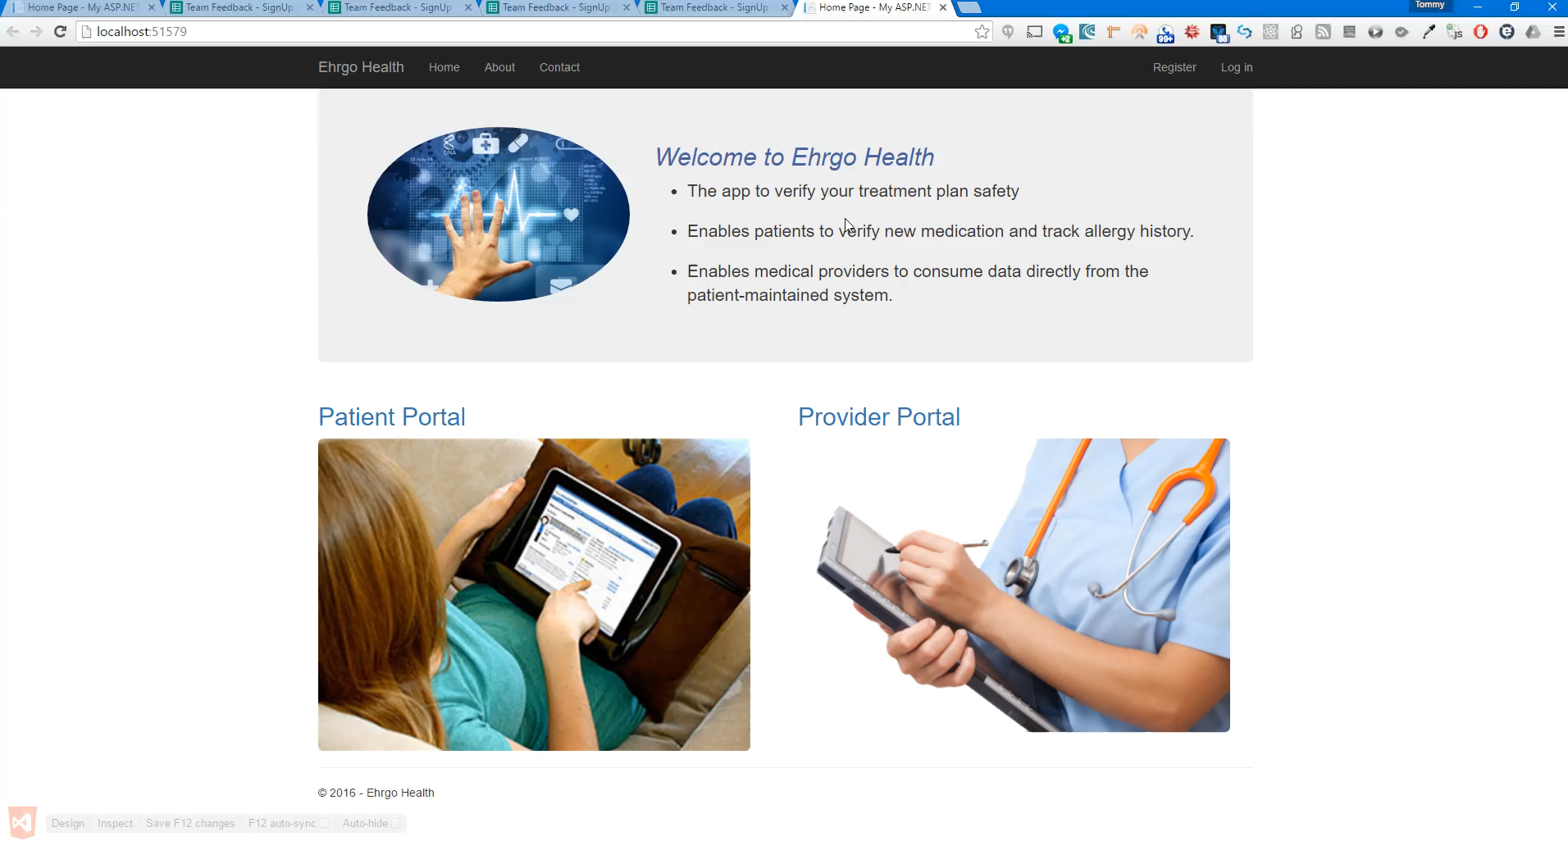

Slide 9
Ehrgo Health Team Members
Eric Greene: Project Manager/Developer
Huarui Zheng: Developer/Tester
Donna Carey: Documentation Lead/Developer
Tommy Parnell: Development Lead/Documentation Narrator
James Ruiz: Developer/Tester
Notes:
Prepare slides for the appendix in the event that more details or supplemental slides are needed. The appendix is also useful if the presentation is distributed later.

